Slide 1

Francis and Vavrus, 2013
https://www.youtube.com/watch?v=8eyNm2QcOw8&feature=youtu.be

Slide 2
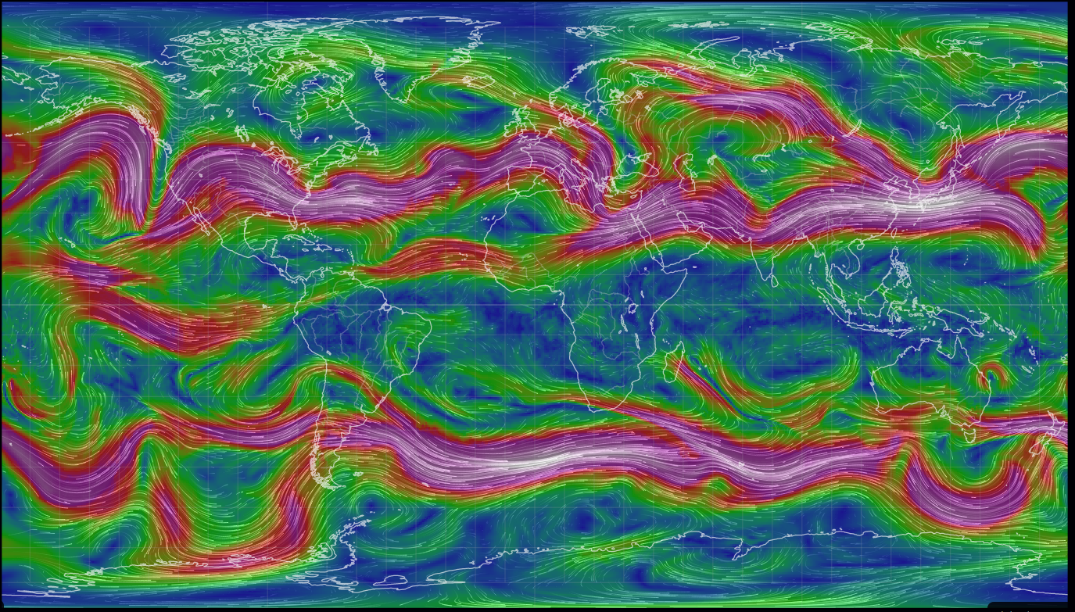
Jet stream forms a meandering boundary between cold Polar air and warmer mid-latitude air
Cold Arctic air
Warm mid-latitude air
Cold Antarctic air

Slide 3
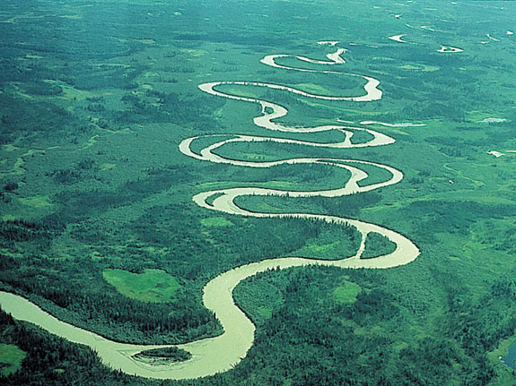
But meandering happens more when the terrain is flat

Slide 4
Warmer Arctic -> less temperature difference between Arctic and mid-latitude -> jet is wavier and slower
Cold Arctic air
Warm mid-latitude air
Cold Antarctic air

Slide 5
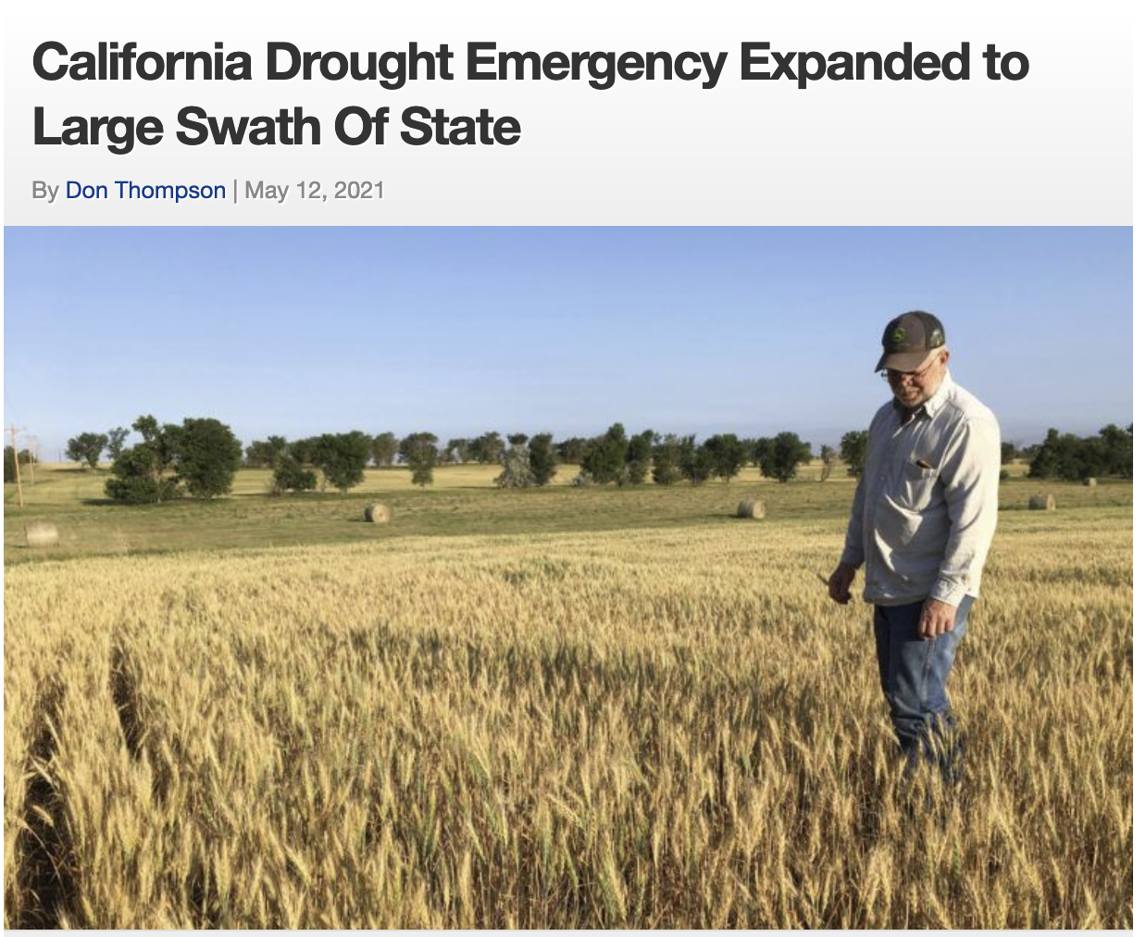
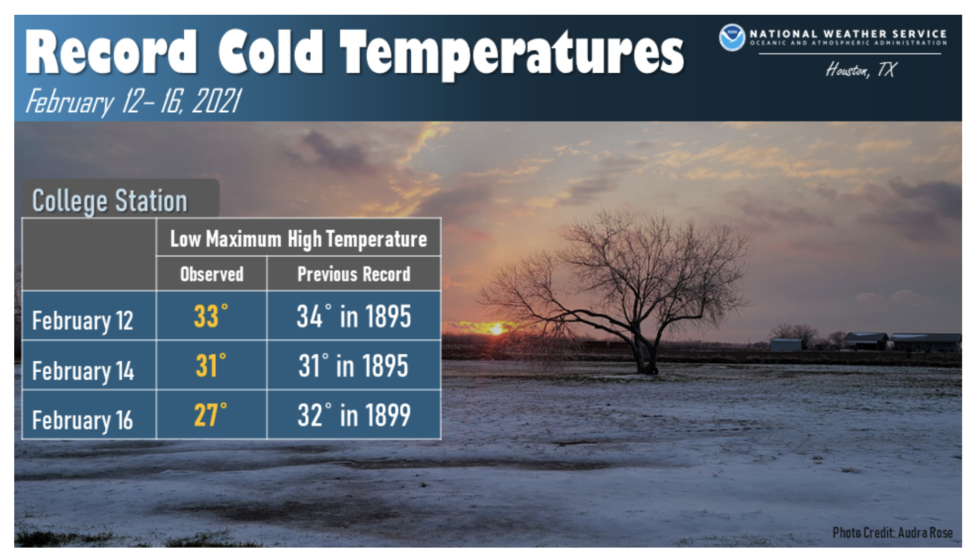

Warmer Arctic -> less temperature difference between Arctic and mid-latitude -> jet is wavier and slower -> prolonged periods of drought and cold

Slide 6
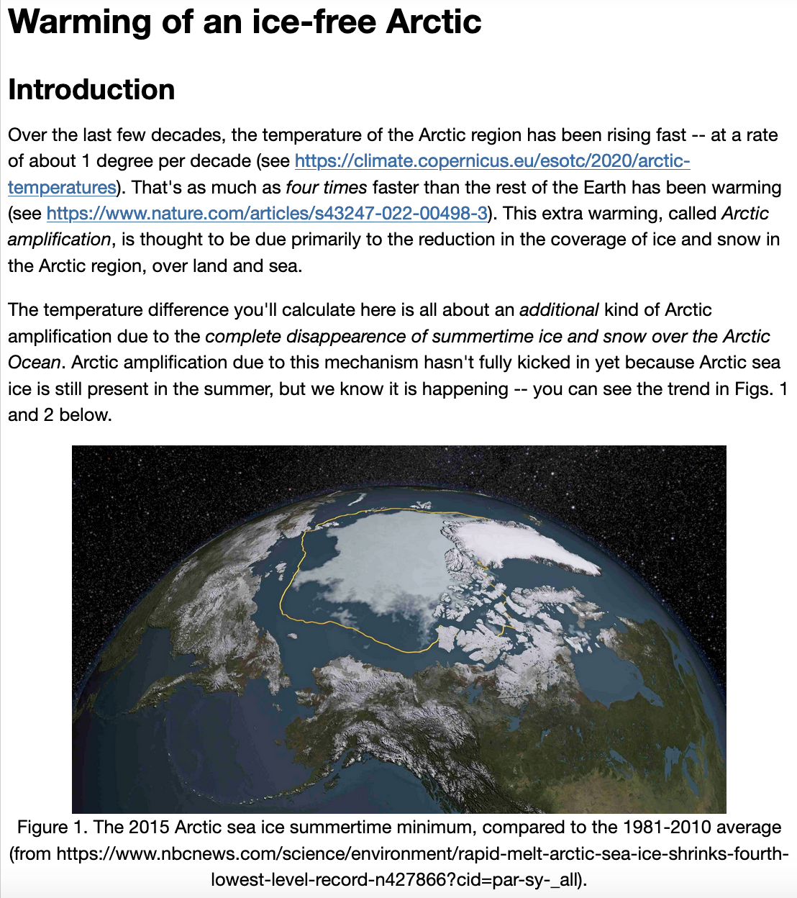
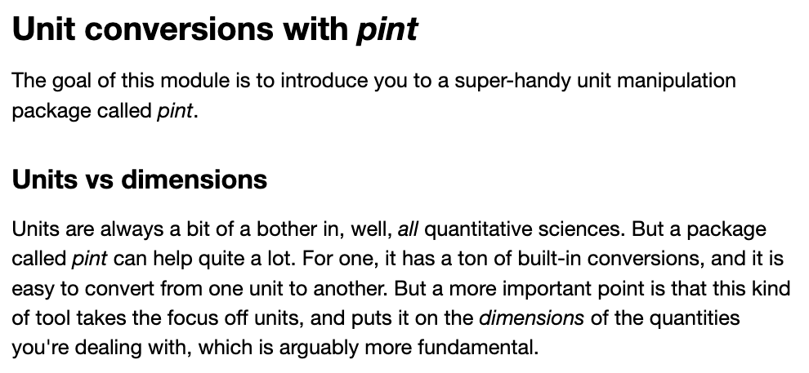
OK, let’s do this

